Slide 1
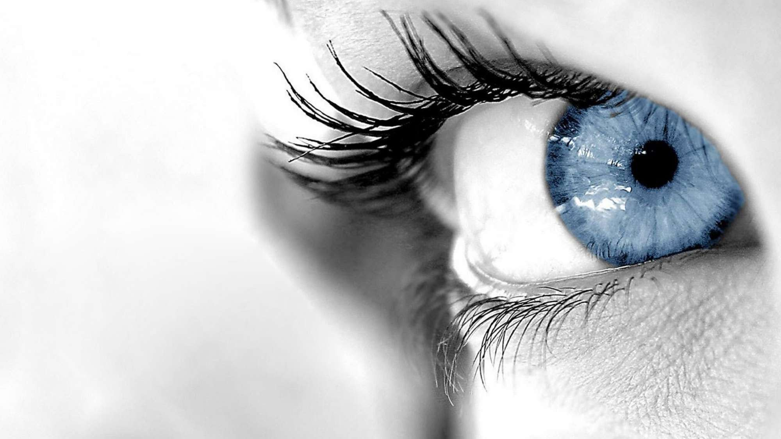
Deep Learning for Computer Vision
Reviews & advances
6.S191 Introduction to Deep Learning
introtodeeplearning.com ^{1/29/19}

Slide 2
Convolutional Neural Networks (CNNs)

Slide 3
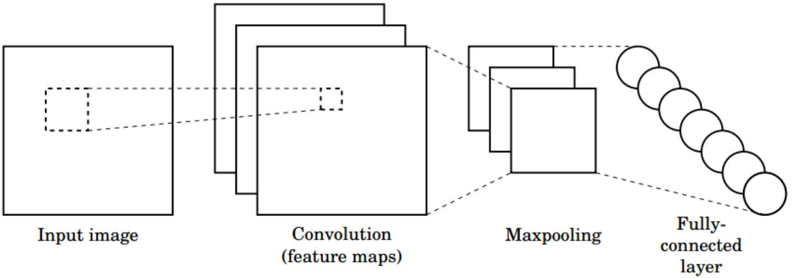
CNNs for Classification
Convolution: Apply filters with learned weights to generate feature maps.
Non-linearity: Often ReLU.
Pooling: Downsampling operation on each feature map.
Train model with image data.
Learn weights of filters in convolutional layers.
1/29/19

Slide 4
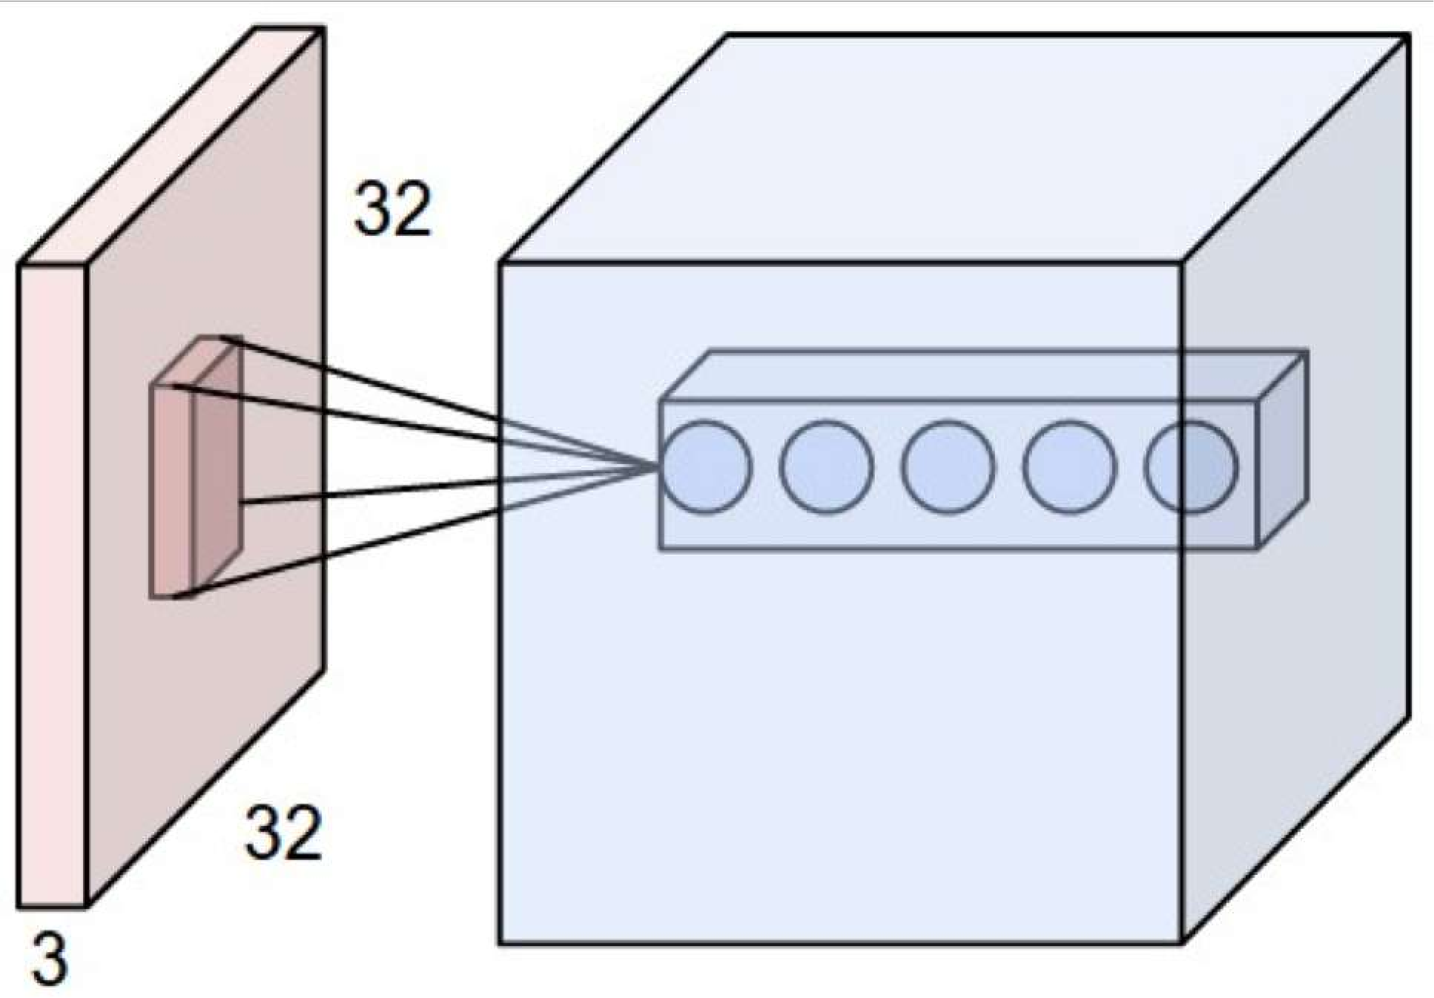
CNNs: Spatial Arrangement of Output Volume
depth
Layer Dimensions:
ℎ * w * d
where h and w are spatial dimensions
height
d (depth) = number of filters
Stride:
Filter step size
Receptive Field: Locations in input image that a node is path connected to
width
[3] 1/29/19

Slide 5
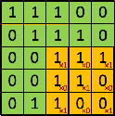
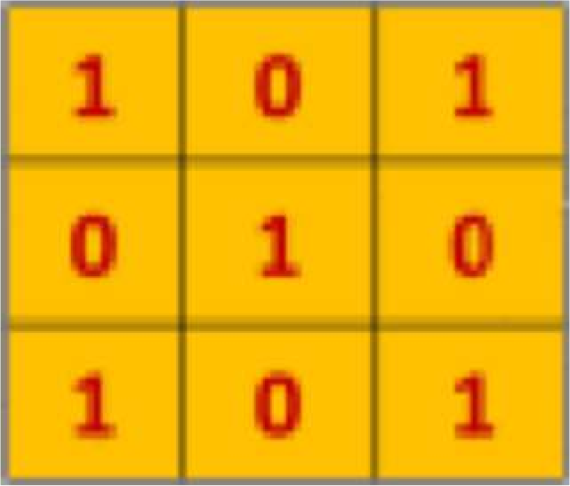
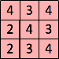
The Convolution Operation
We slide the 3x3 filter over the input image, element-wise multiply, and add the outputs:
filter
feature map
[5] 1/29/19

Slide 6
CNNs for Classification: ImageNet

Slide 7
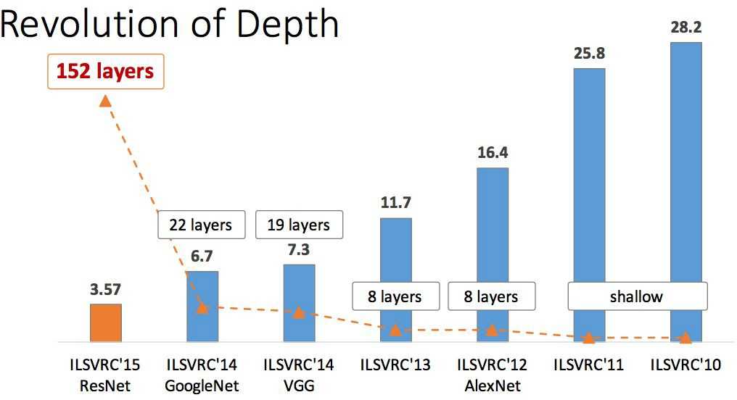
ImageNet Large Scale Visual Recognition Challenge (ILSVRC) winners
First CNN-based winner
Fei-Fei Li & Justin Johnson & Serena Yeung Lecture 9 - May 2, 2017

Slide 8
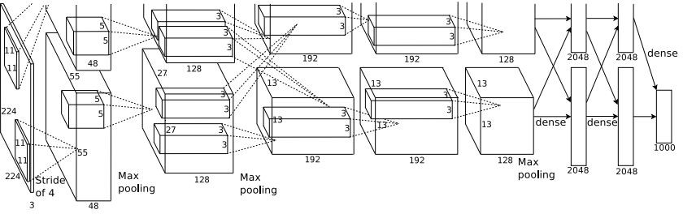
Case Study: AlexNet
Full (simplified) AlexNet architecture: [227x227x3] INPUT
[55x55x96] CONV1: 96 11x11 filters at stride 4, pad 0 [27x27x96] MAX POOL1: 3x3 filters at stride 2 [27x27x96] NORM1: Normalization layer
[27x27x256] CONV2: 256 5x5 filters at stride 1, pad 2 [13x13x256] MAX POOL2: 3x3 filters at stride 2 [13x13x256] NORM2: Normalization layer [13x13x384] CONV3: 384 3x3 filters at stride 1, pad 1 [13x13x384] CONV4: 384 3x3 filters at stride 1, pad 1 [13x13x256] CONV5: 256 3x3 filters at stride 1, pad 1 [6x6x256] MAX POOL3: 3x3 filters at stride 2
Details/Retrospectives:
first use of ReLU
used Norm layers (not common anymore)
heavy data augmentation
dropout 0.5
batch size 128
SGD Momentum 0.9
Learning rate 1e-2, reduced by 10 manually when val accuracy plateaus
L2 weight decay 5e-4
[4096] FC6: 4096 neurons
[4096] FC7: 4096 neurons
[1000] FC8: 1000 neurons (class scores)
- 7 CNN ensemble: 18.2% -> 15.4%
Fei-Fei Li & Justin Johnson & Serena Yeung Lecture 9 - May 2, 2017

Slide 9
Case Study: VGGNet
Softmax
FC 1000
FC 4096
FC 4096
Pool
3x3 conv, 512
3x3 conv, 512
3x3 conv, 512
3x3 conv, 512
Pool
3x3 conv, 512
3x3 conv, 512
3x3 conv, 512
3x3 conv, 512
Pool
3x3 conv, 256
3x3 conv, 256
Pool
3x3 conv, 128
3x3 conv, 128
Pool
3x3 conv, 64
3x3 conv, 64
Input
Softmax
FC 1000
FC 4096
FC 4096
Pool
3x3 conv, 512
3x3 conv, 512
3x3 conv, 512
Pool
3x3 conv, 512
3x3 conv, 512
Small filters, Deeper networks
8 layers (AlexNet)
-> 16 - 19 layers (VGG16Net)
Only 3x3 CONV stride 1, pad 1 and 2x2 MAX POOL stride 2
Softmax
FC 1000
FC 4096
FC 4096
Pool
3x3 conv, 256
3x3 conv, 384
Pool
3x3 conv, 384
Pool
5x5 conv, 256
11x11 conv, 96
Input
3x3 conv, 512
Pool
3x3 conv, 256
3x3 conv, 256
Pool
3x3 conv, 128
3x3 conv, 128
Pool
3x3 conv, 64
3x3 conv, 64
Input
11.7% top 5 error in ILSVRC’13 (ZFNet)
-> 7.3% top 5 error in ILSVRC’14
AlexNet
VGG16
VGG19

Slide 10
Case Study: VGGNet
Softmax
FC 1000
FC 4096
FC 4096
Pool
3x3 conv, 512
3x3 conv, 512
3x3 conv, 512
3x3 conv, 512
Pool
3x3 conv, 512
3x3 conv, 512
3x3 conv, 512
3x3 conv, 512
Pool
3x3 conv, 256
3x3 conv, 256
Pool
3x3 conv, 128
3x3 conv, 128
Pool
3x3 conv, 64
3x3 conv, 64
Input
Softmax
FC 1000
FC 4096
FC 4096
Pool
3x3 conv, 512
3x3 conv, 512
3x3 conv, 512
Pool
3x3 conv, 512
3x3 conv, 512
Q: Why use smaller filters? (3x3 conv)
Stack of three 3x3 conv (stride 1) layers has same effective receptive field as one 7x7 conv layer
But deeper, more non-linearities
Softmax
FC 1000
FC 4096
FC 4096
Pool
3x3 conv, 256
3x3 conv, 384
Pool
3x3 conv, 384
Pool
5x5 conv, 256
11x11 conv, 96
Input
3x3 conv, 512
Pool
3x3 conv, 256
3x3 conv, 256
Pool
3x3 conv, 128
3x3 conv, 128
Pool
3x3 conv, 64
3x3 conv, 64
Input
2 2
And fewer parameters: 3 * (3 C ) vs. 7²C² for C channels per layer
AlexNet
VGG16
VGG19
Fei-Fei Li & Justin Johnson & Serena Yeung Lecture 9 - May 2, 2017

Slide 11
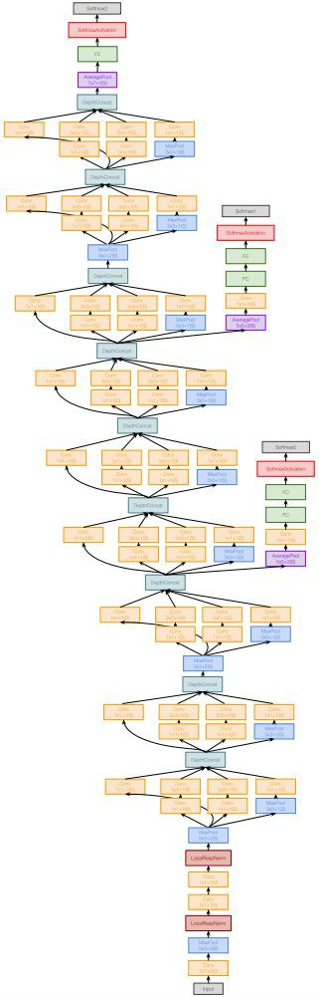
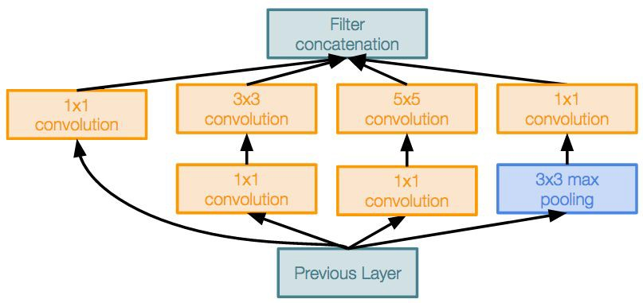
Case Study: GoogLeNet
Deeper networks, with computational efficiency
22 layers
Efficient “Inception” module
No FC layers
Only 5 million parameters!
12x less than AlexNet
ILSVRC’14 classification winner (6.7% top 5 error)
Inception module
多个分路对同一个输入进行xxx
Fei-Fei Li & Justin Johnson & Serena Yeung Lecture 9 - May 2, 2017

Slide 12
Reminder: 1x1 convolutions
1x1 CONV
with 32 filters
56
56
压缩
preserves spatial dimensions, reduces depth!
56
Projects depth to lower dimension (combination of feature maps)
56
64
32
Fei-Fei Li & Justin Johnson & Serena Yeung Lecture 9 - May 2, 2017

Slide 13
Case Study: ResNet
[He et al., 2015]
Softmax
FC 1000
Pool
3x3 conv, 64
3x3 conv, 64
relu
3x3 conv, 64
Very deep networks using residual connections
3x3 conv, 64
F(x) + x
3x3 conv, 64
3x3 conv, 64
..
.
conv
152-layer model for ImageNet
ILSVRC’15 classification winner (3.57% top 5 error)
Swept all classification and detection competitions in ILSVRC’15 and COCO’15!
3x3 conv, 128
F(x)
X
identity
3x3 conv, 128
relu
3x3 conv, 128
conv
3x3 conv, 128
3x3 conv, 128
3x3 conv, 128 / 2
3x3 conv, 64
X
Residual block
3x3 conv, 64
特别深的网络
解决梯度消散的问题
往前传
前端进行修正
增强梯度的传递
3x3 conv, 64
3x3 conv, 64
3x3 conv, 64
3x3 conv, 64
Pool
7x7 conv, 64 / 2
Input
Fei-Fei Li & Justin Johnson & Serena Yeung Lecture 9 - May 2, 2017

Slide 14
Object Detection

Slide 15
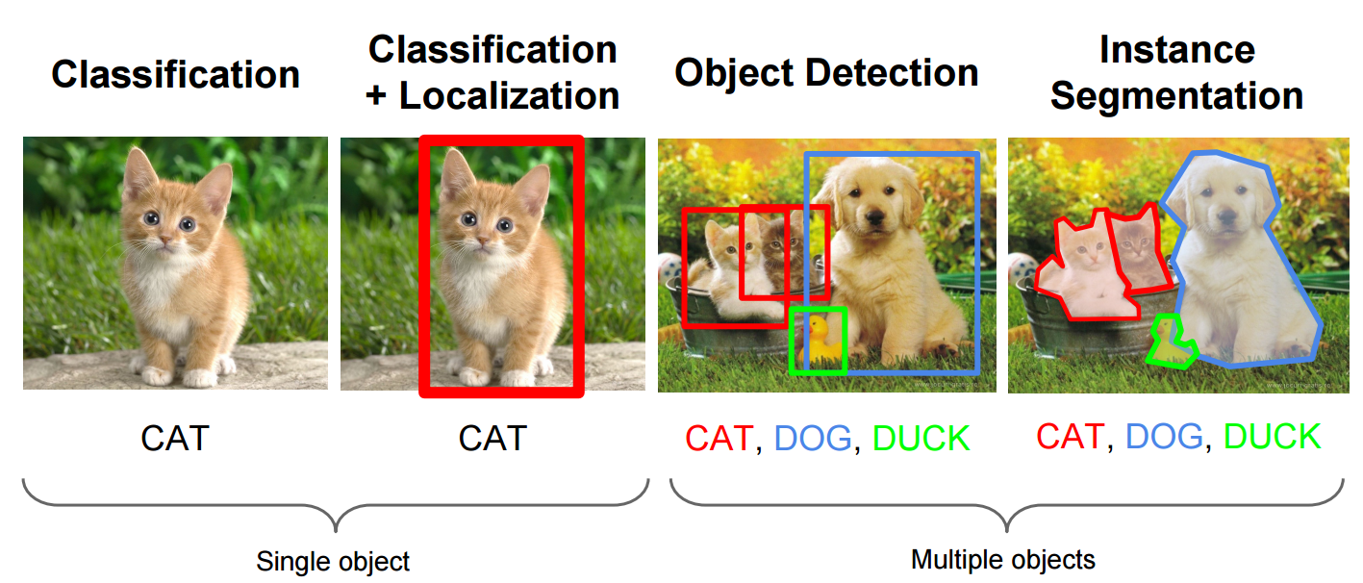
What is object detection
http://cs231n.stanford.edu/slides/winter1516_lecture8.pdf

Slide 16
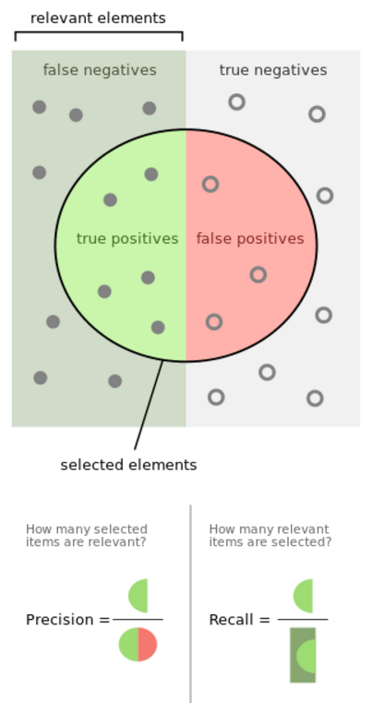

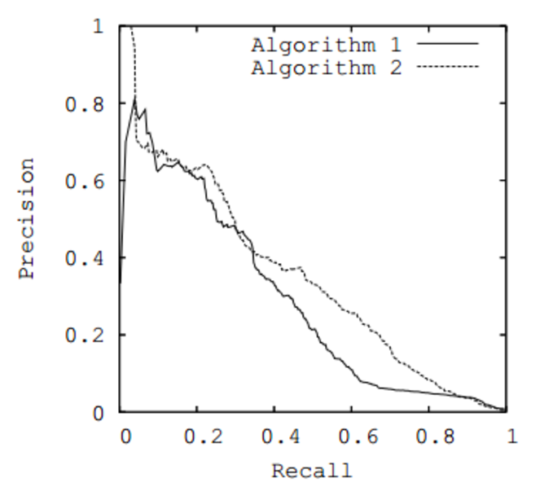
Terms
Recall
Precision
mAP
IoU
混淆矩阵
计算出recall和precision的值
AP：曲线图中所围起来的面积
mAP，多类别的平均指标
LOU：两个框的交集除以两个框的并集
Notes:
Add recall precision curve

Slide 17
Two Stage Detection
Part I

Slide 18
R-CNN: Region proposals + CNN features
SVMs
Classify regions with SVMs
SVMs
ConvNet
SVMs
ConvNet
Forward each region through ConvNet
ConvNet
1.抠出来的图像生成小图像
2.生成对应的feature map
3.再用SVM进行训练
Warped image regions
Region proposals
Input image
R. Girshick, J. Donahue, T. Darrell, and J. Malik, Rich Feature Hierarchies for Accurate Object Detection and Semantic Segmentation, CVPR 2014.
Notes:
The features are also sent to a linear regressor that improves object localization.
The components outlined in purple are “post hoc” in the sense that they are learned after the convnet weights are trained and forever frozen.

Slide 19
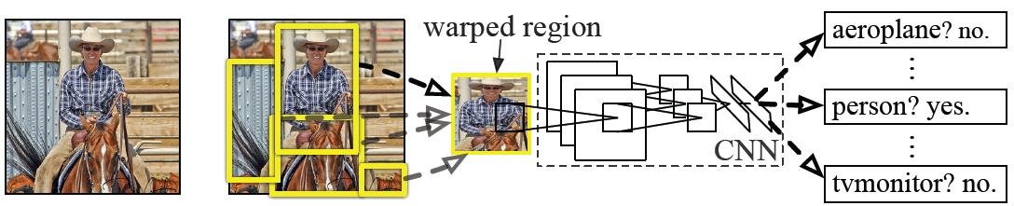
R-CNN details
Regions: ~2000 Selective Search proposals
Network: AlexNet pre-trained on ImageNet (1000 classes), fine-tuned on PASCAL (21 classes)
Final detector: warp proposal regions, extract fc7 network activations (4096 dimensions), classify with linear SVM
Bounding box regression to refine box locations
Performance: mAP of 53.7% on PASCAL 2010 (vs. 35.1% for Selective Search and 33.4% for Deformable Part Models)
Notes:
Object detection system overview. Our system (1) takes an input image, (2) extracts around 2000 bottom-up region proposals, (3) computes features for each proposal using a large convolutional neural network (CNN), and then (4) classifies each region using class-specific linear SVMs. R-CNN achieves a mean average precision (mAP) of 53.7% on PASCAL VOC 2010. For comparison, Uijlings et al. (2013) report 35.1% mAP using the same region proposals, but with a spatial pyramid and bag-of-visual-words approach. The popular deformable part models perform at 33.4%.

Slide 20
Fast R-CNN
Softmax classifier
Linear +
softmax
Linear
Bounding-box regressors
FCs
Fully-connected layers
RoI Pooling layer
Region proposals
Conv5 feature map of image
ConvNet
1.先生成整幅图的feature map(特征图)
2.再回原图像求候选框，映射到之前生成的feature map上再抠出来
（这样能快速的获取候选框）
3.统一尺寸
4.候选框的对应预测
Forward whole image through ConvNet
Source: R. Girshick
R. Girshick, Fast R-CNN, ICCV 2015
Notes:
Rather than using post-hoc bounding-box regressors, bounding-box regression is implemented as an additional linear layer in the network

Slide 21
Fast R-CNN
Softmax 分类器
线性 +softmax
线性
限定框解释变量
FCs
全层
RoI Pooling 层
候选区域
卷积层的第五层的图像的特征映射
1.先生成整幅图的feature map(特征图)
2.再回原图像求候选框，映射到之前生成的feature map上再抠出来
（这样能快速的获取候选框）
3.统一尺寸
4.候选框的对应预测
ConvNet
通过卷积神经网络转发整个图像
Source: R. Girshick
R. Girshick, Fast R-CNN, ICCV 2015
Notes:
Rather than using post-hoc bounding-box regressors, bounding-box regression is implemented as an additional linear layer in the network

Slide 22
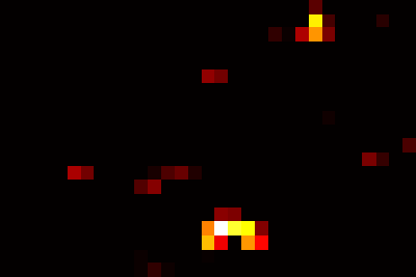
RoI pooling
“Crop and resample” a fixed-size feature representing a region of interest out of the outputs of the last conv layer
Use nearest-neighbor interpolation of coordinates, max pooling
“裁剪和重采样”一个固定大小的特征表示一个感兴趣的区域输出的最后一个conv层使用最近邻插值坐标，最大池
Conv feature map
RoI pooling layer
FC layers …
Region of Interest (RoI)
RoI feature
Source: R. Girshick, K. He

Slide 23
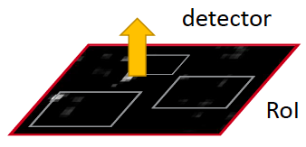
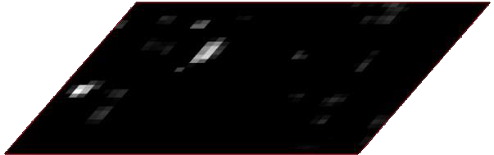
Faster R-CNN
Region proposals
Region Proposal Network
feature map
feature map
CNN
CNN
share features
S. Ren, K. He, R. Girshick, and J. Sun, Faster R-CNN: Towards Real-Time Object Detection with Region Proposal Networks, NIPS 2015

Slide 24
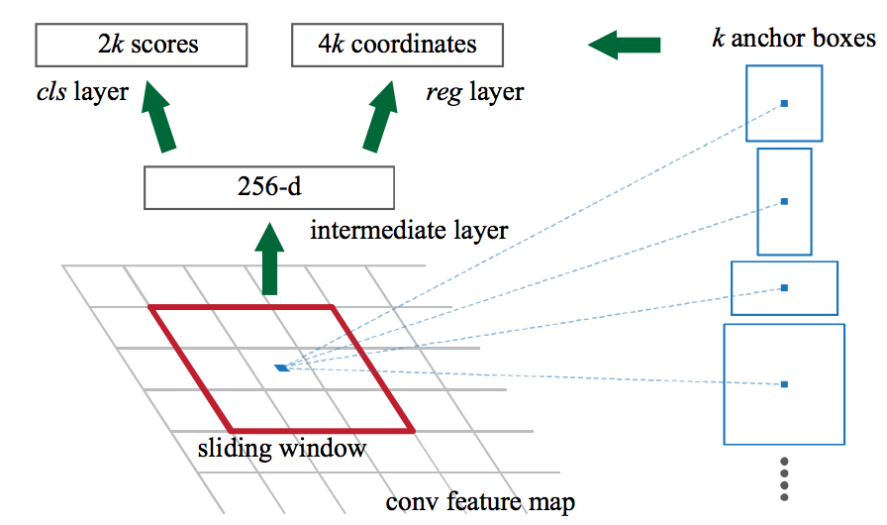
Region proposal network (RPN)
Slide a small window (3x3) over the conv5 layer
Predict object/no object
Regress bounding box coordinates with reference to anchors (3 scales x 3 aspect ratios)
Notes:
At each sliding-window location, we simultaneously predict multiple region proposals, where the number of maximum possible proposals for each location is denoted as k. So the reg layer has 4k outputs encoding the coordinates of k boxes, and the cls layer outputs 2k scores that estimate probability of object or not object for each proposal

Slide 25

One network, four losses
Classification loss
Bounding-box regression loss
…
Classification loss
Bounding-box regression loss
RoI pooling
proposals
Region Proposal Network
feature map
CNN
Source: R. Girshick, K. He
image

Slide 26
Unified Detection
Part II

Slide 27
YOLO
Take conv feature maps at 7x7 resolution
Add two FC layers to predict, at each location, a score for each class and 2 bboxes w/ confidences
For PASCAL, output is 7x7x30 (30 = 20 + 2*(4+1))
J. Redmon, S. Divvala, R. Girshick, and A. Farhadi, You Only Look Once: Unified, Real-Time Object Detection, CVPR 2016

Slide 28
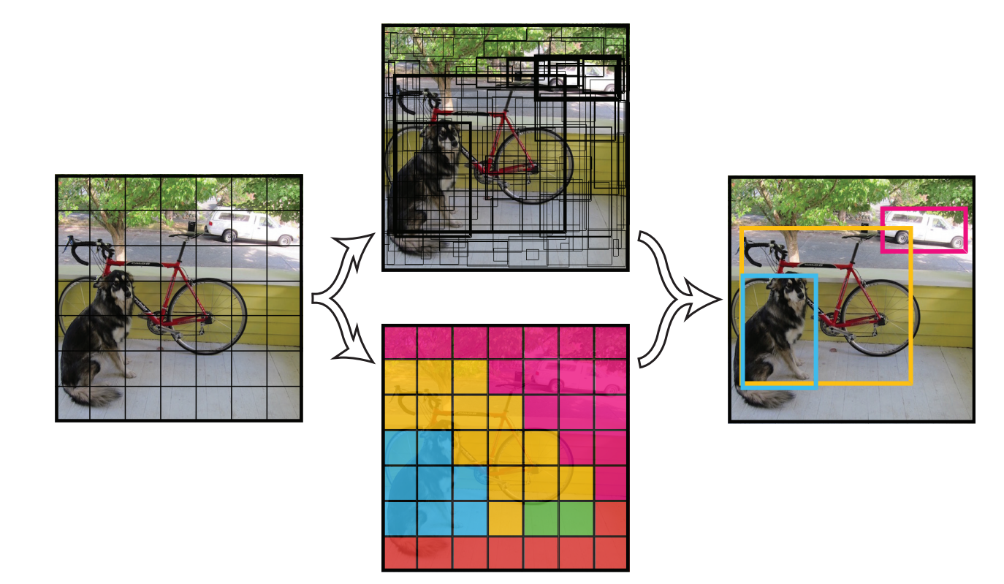
How it works
The following predictions are made for each cell in an S x S grid.
C conditional class probabilities Pr(Class_{i} | Obj)
B bounding boxes (4 parameters each)
B confidence scores Pr(Obj)*IoU
Output is S x S x (5B+C) tensor
https://arxiv.org/pdf/1506.02640v5.pdf

Slide 29
Others
Part III

Slide 30
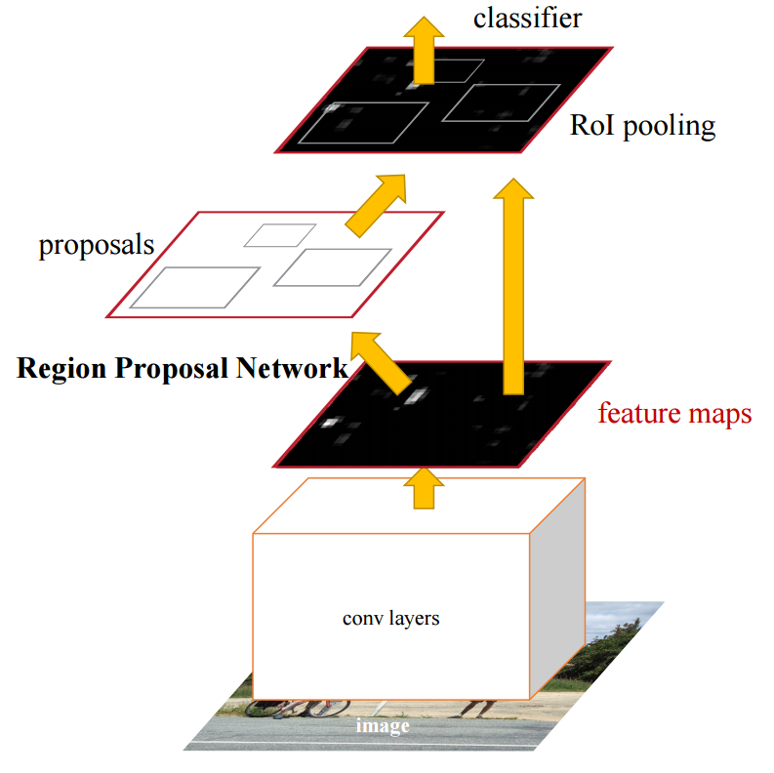
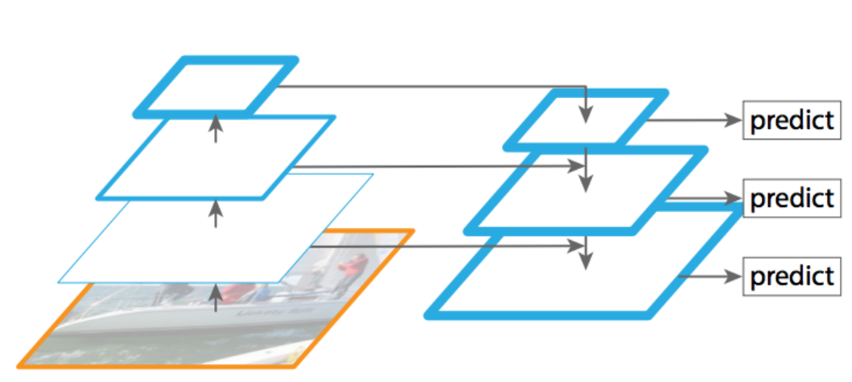
Feature Pyramid Networks for RPN
Replace single scale feature map with FPN.
Single scale anchors at each level.
https://arxiv.org/pdf/1512.02325v5.pdf

Slide 31
Semantic Segmentation, Dense Labeling

Slide 32
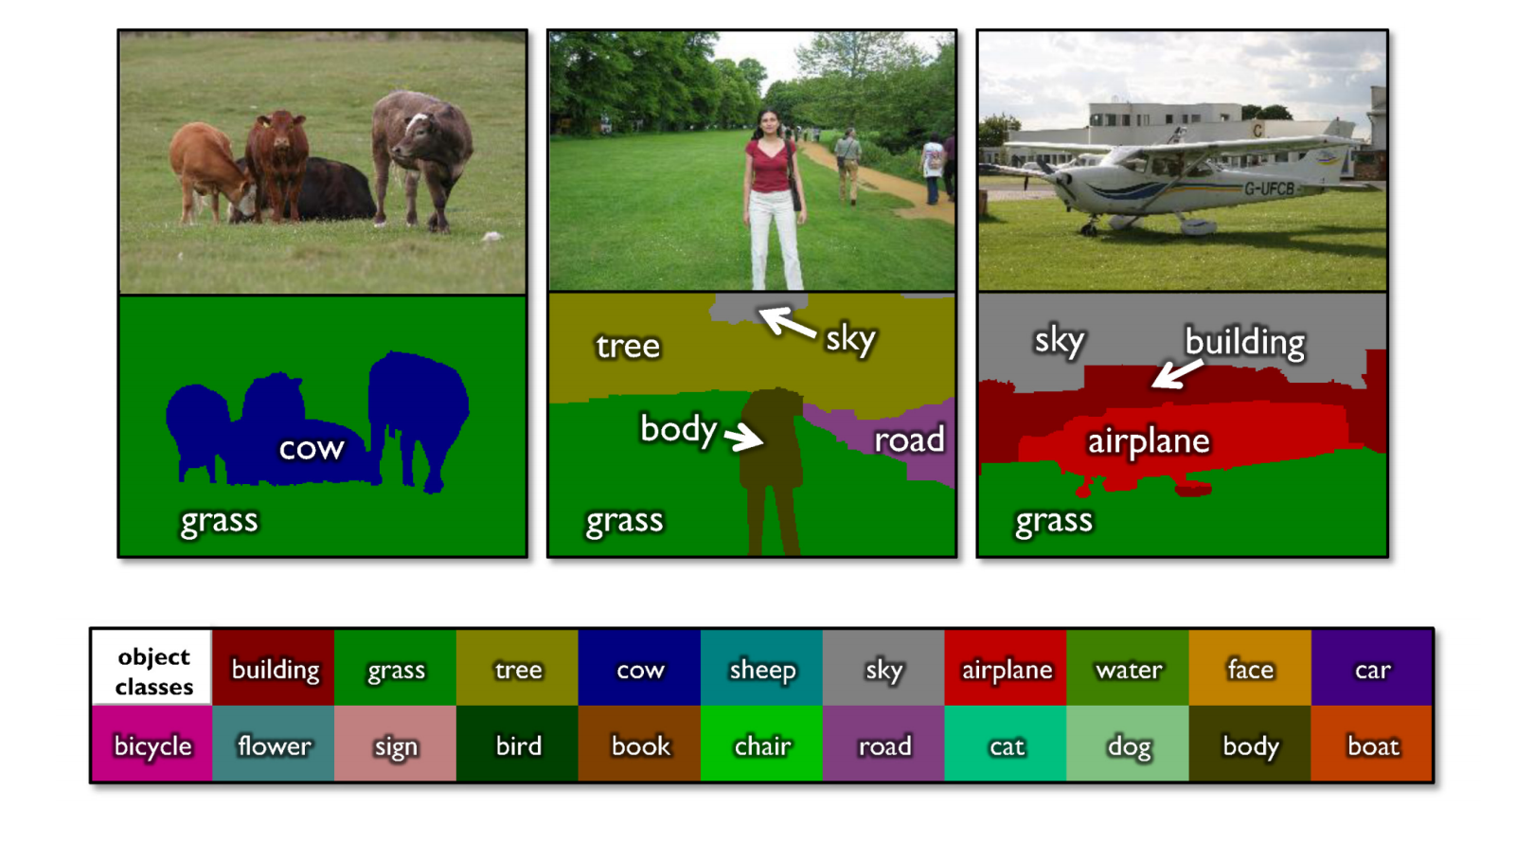
Semantic segmentation
From CS543 LAZ

Slide 33
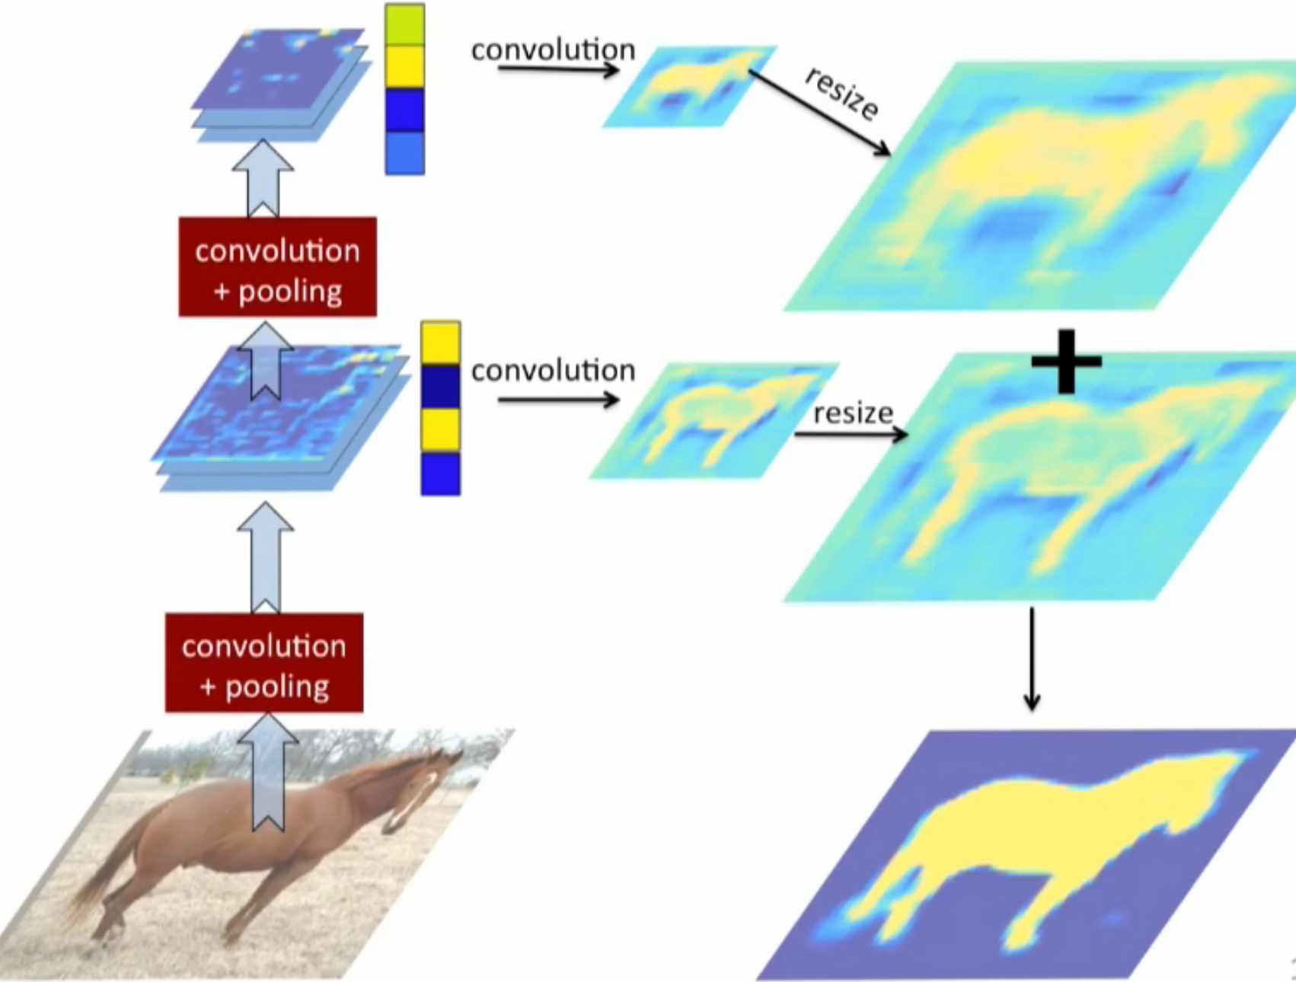
Hypercolumn Representation
反卷积
上采样
还原大一点的图像
语义分割和目标检测类似
重要 保留
upsampling
Hypercolumns for object segmentation and fine-grained localization CVPR 2015

Slide 34
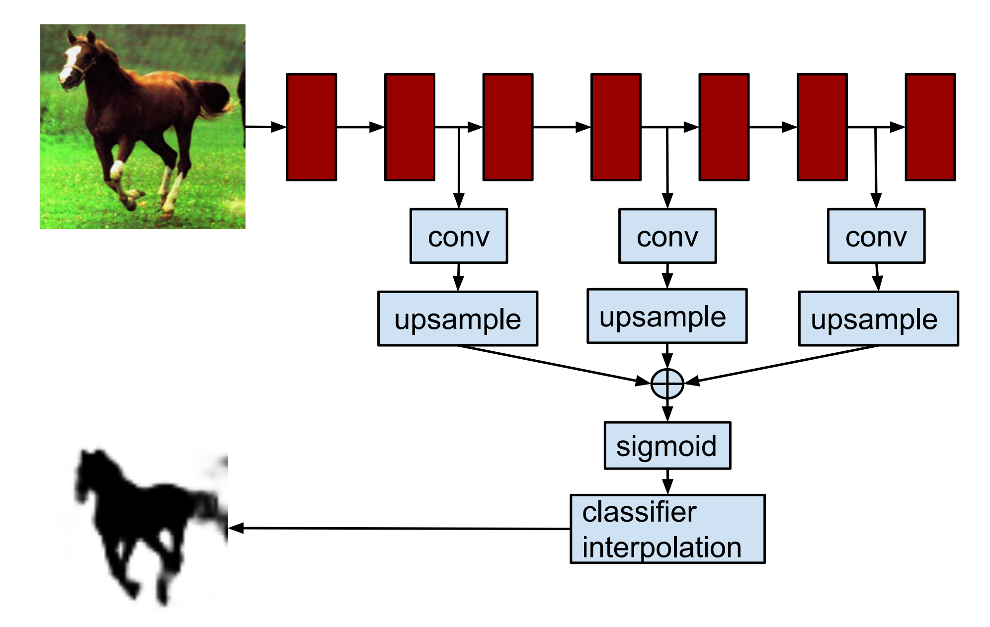
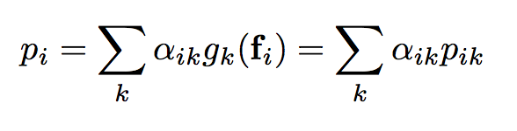
Hypercolumn Representation
Hypercolumns for object segmentation and fine-grained localization CVPR 2015

Slide 35
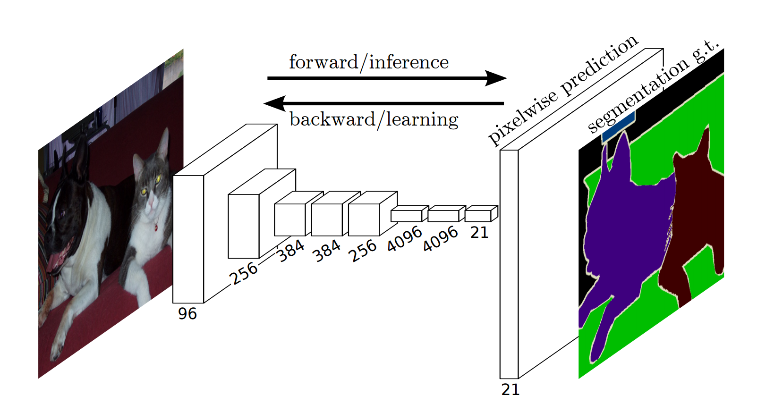
FCN for Semantic Segmentation
Fully convolutional Networks for Semantic Segmentation, CVPR 2015

Slide 36
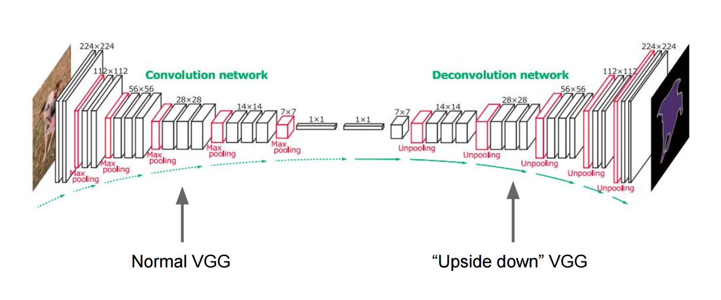
More than one upsampling layer
Noh et al, “Learning Deconvolution Network for Semantic Segmentation”, ICCV 2015

Slide 37
Advances in Computer Vision

Slide 38
Generative Adversarial Networks (GANs)
生成对抗神经网络

Slide 39
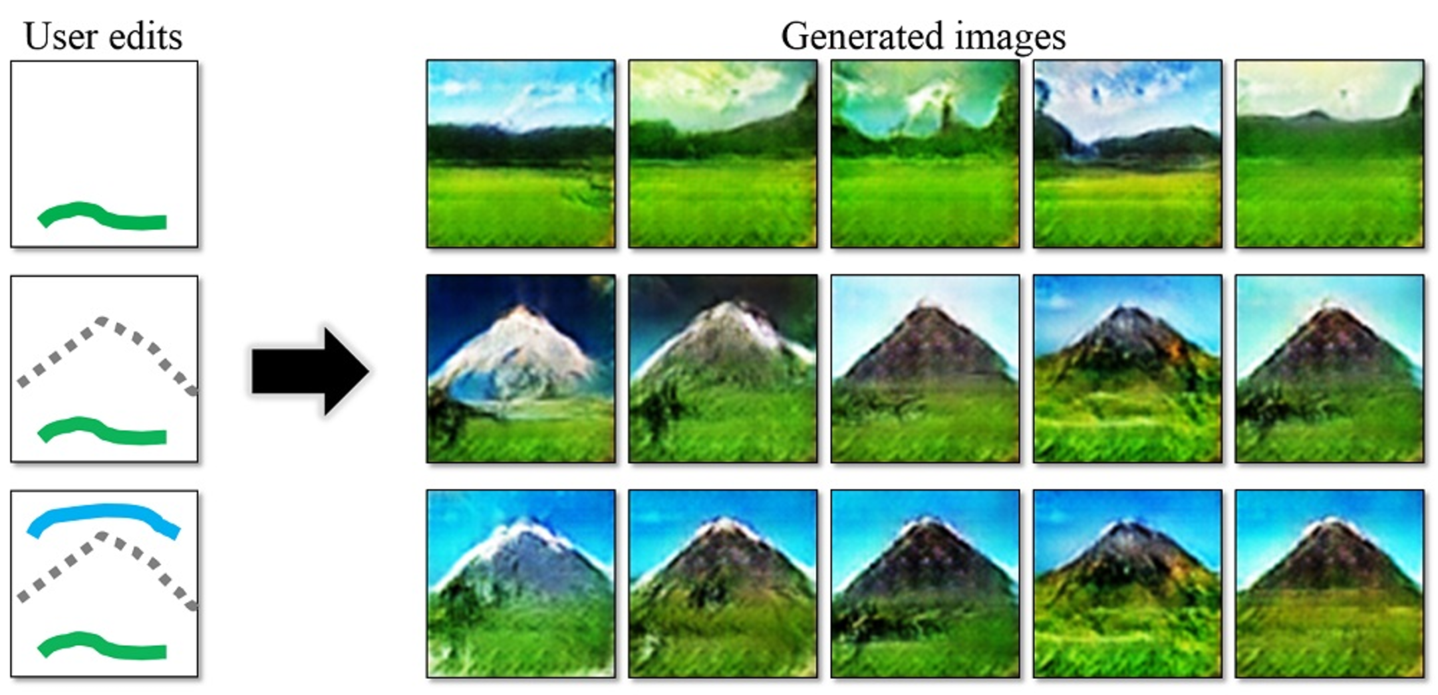
Magic of GANs…
一副生成图像和原始图像的差距
Notes:
-- Draw strokes and the network generates images for you.

Slide 40
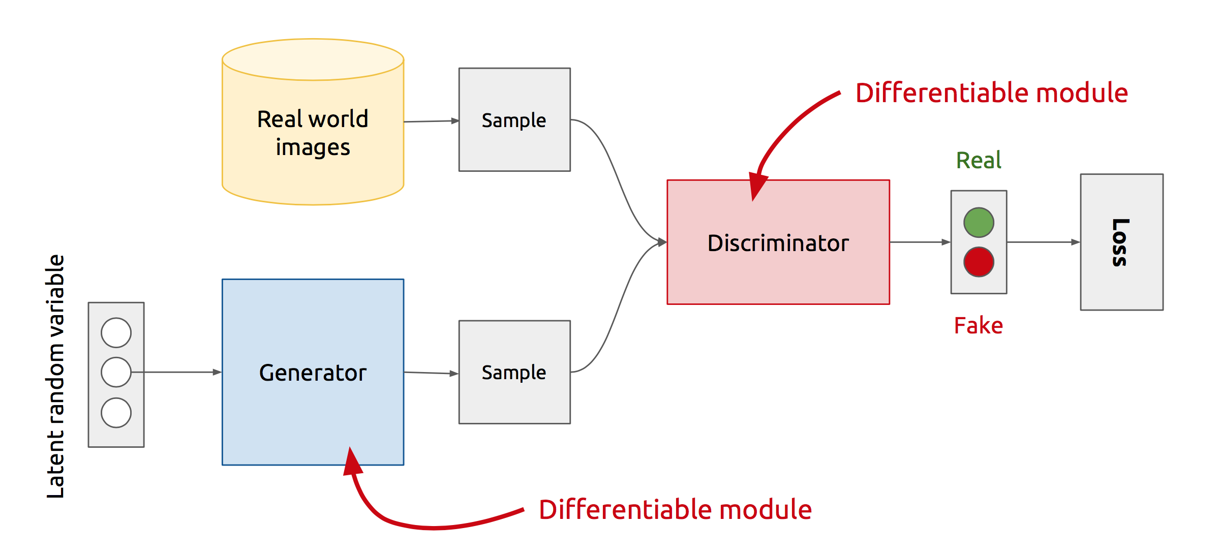
GAN’s Architecture
x
D
D(x)
G
z
G(z)
D(G(z))
Z is some random noise (Gaussian/Uniform).
Z can be thought as the latent representation of the image.
Notes:
Let’s look at the real GAN architecture now :-
-- We have two networks here Generator and Discriminator
-- Discriminator gets input from both the Generator and Real training samples and predicts which one is real and which one is fake.
-- The way Generator generates fake images is .. It randomly samples a noise z, passes it through its network, and the output of the network gives us the image.
-- So, the rationale with that will be that z is sort of your latent representation for the image.. And you generate the image from your latent representation by passing it through the generator network.
Never directly see true samples.

Slide 41
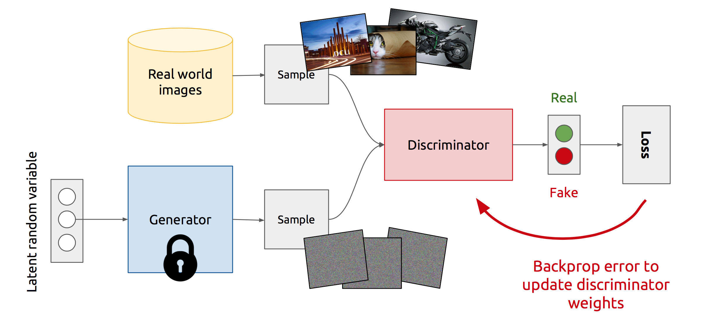
Training Discriminator
Notes:
So, this is how GANs operate :-
At the start of the iteration, a true example is selected and passed through the discriminator. The discriminator outputs the probability of it being a real example, calculate its loss, and update its weights while keeping the generator weights as constant.

Slide 42
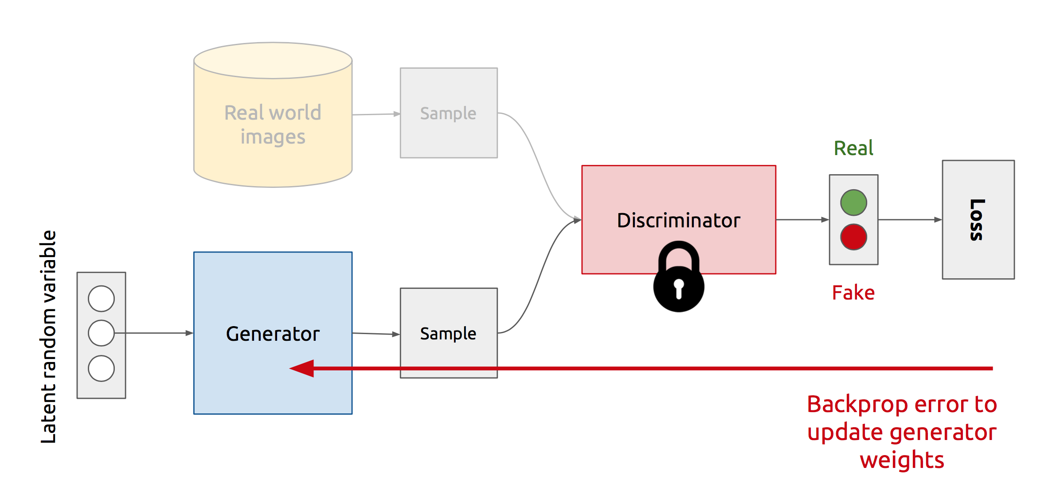
Training Generator
Notes:
Now :-
Generator selects a random noise z, passes it through the generator network to generate a fake image, and then passes it through the discriminator network to output the probability of it being fake. It then calculates its loss, and update its weights while keeping the discriminator’s weights as constant
And we repeat this process of Alternate updates.
Act as complicated loss function.

Slide 43
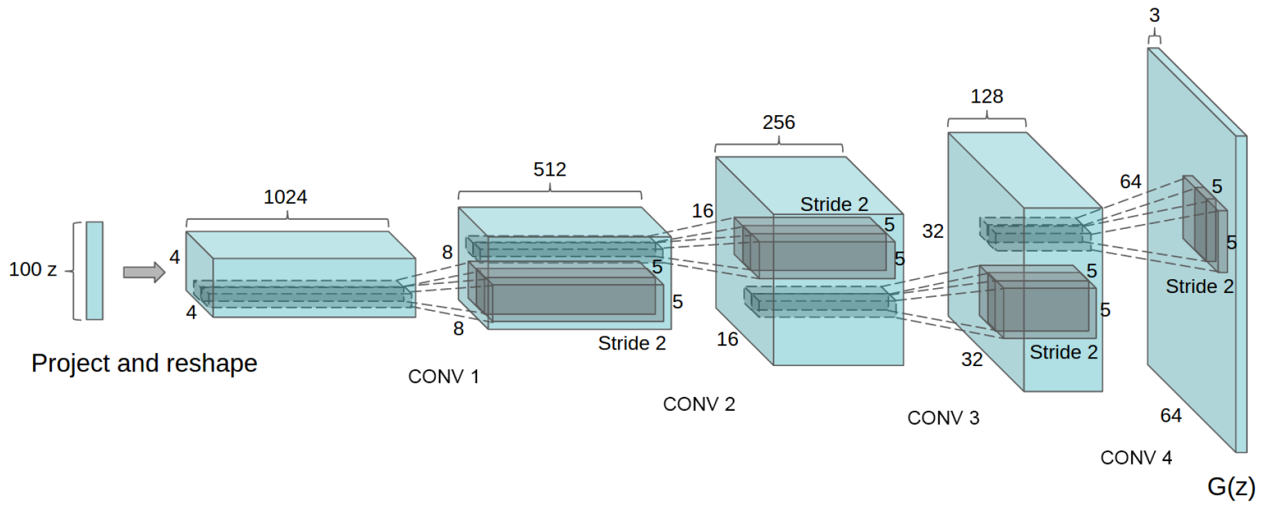
Deep Convolutional GANs (DCGANs)
Key ideas:
Replace FC hidden layers with Convolutions
Generator: Fractional-Strided convolutions
Use Batch Normalization after each layer
Inside Generator
Use ReLU for hidden layers
Use Tanh for the output layer
Generator Architecture
Notes:
[..]
Reference :- Fractionally-Strided Convolutions: Liwei’s Presentation

Slide 44
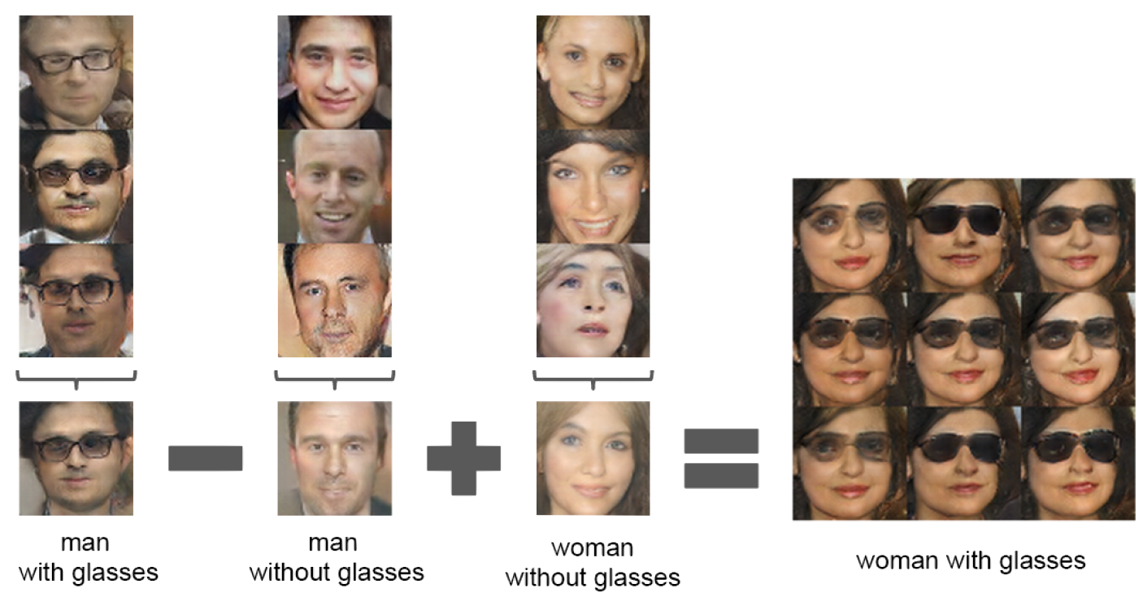
Latent vectors capture interesting patterns…
Notes:
Apart from the visually appearing nature of the images generated by DCGANs, the authors noted another interesting pattern.
i.e. latent vectors support arithmetic over images .. i.e.
if you take the latent vector for a man with glasses,
and subtract that of a man without glasses,
and then add that of a woman without glasses
You get a woman with glasses.
So, we’ll see some more cool things in the later parts of the presentation.

Slide 45
SELF-SUPERVISION

Slide 46
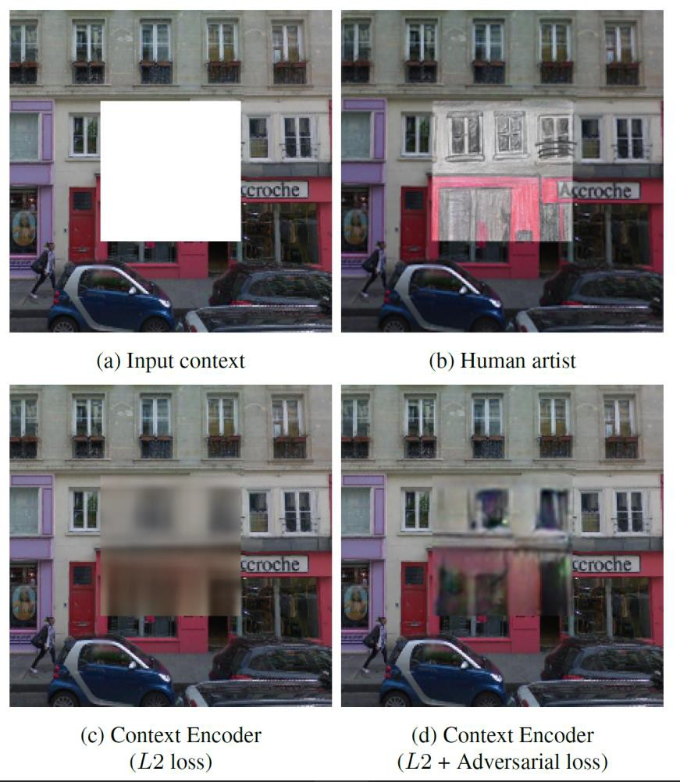
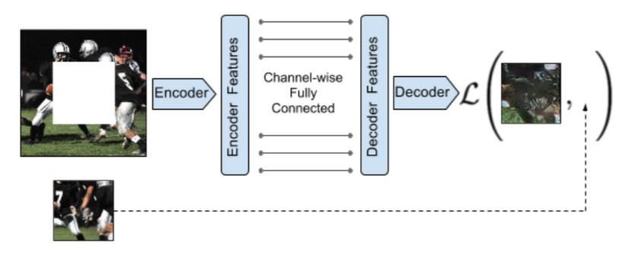
IMAGE IN-PAINTING
Correctly predicting large image patches in a photo realistic manner suggests that model has ability to generalize real world objects.
Context Encoders: Feature Learning by Inpainting Deepak Pathak, Philipp Krahenbuhl, Jeff Donahue, Trevor Darrell, Alexei A. Efros

Slide 47
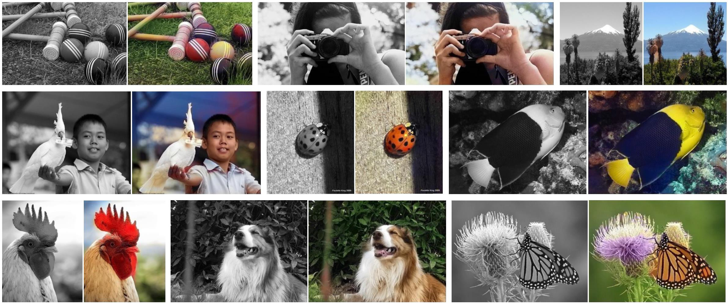
COLORIZE IMAGES
Correctly predicting color suggests understanding of latent object semantics and texture
Figure from Colorful Image Colorization Richard Zhang, Phillip Isola, Alexei A. Efros

Slide 48
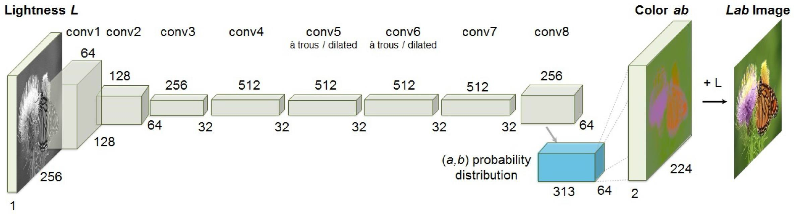
ZHANG ET AL.
NETWORK ARCHITECTURE
Figure from Colorful Image Colorization Richard Zhang, Phillip Isola, Alexei A. Efros
Each Block = 2 to 3 conv + ReLu layers followed by BatchNorm
No Pooling
Dilated Convolutions
Colorful Image Colorization Richard Zhang, Phillip Isola, Alexei A. Efros

Slide 49
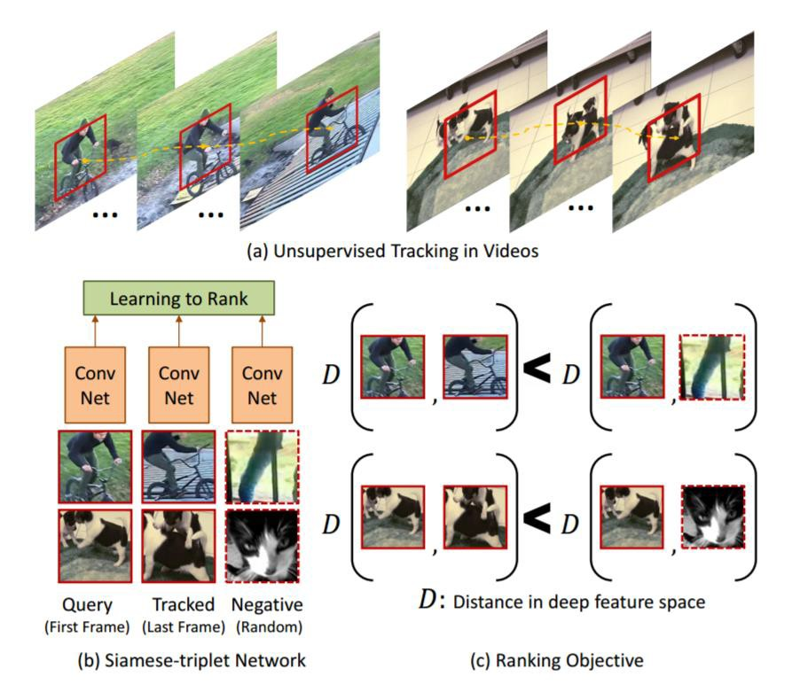
MOTION
Two patches connected by a track should have a similar representation in feature space
Network learns invariance to scaling, lighting, transformation, etc.
Analogous to how infants learn by tracking objects
Xiaolong Wang, Abhinav Gupta, Unsupervised Learning of Visual Representations using Videos, ICCV 2015.

Slide 50
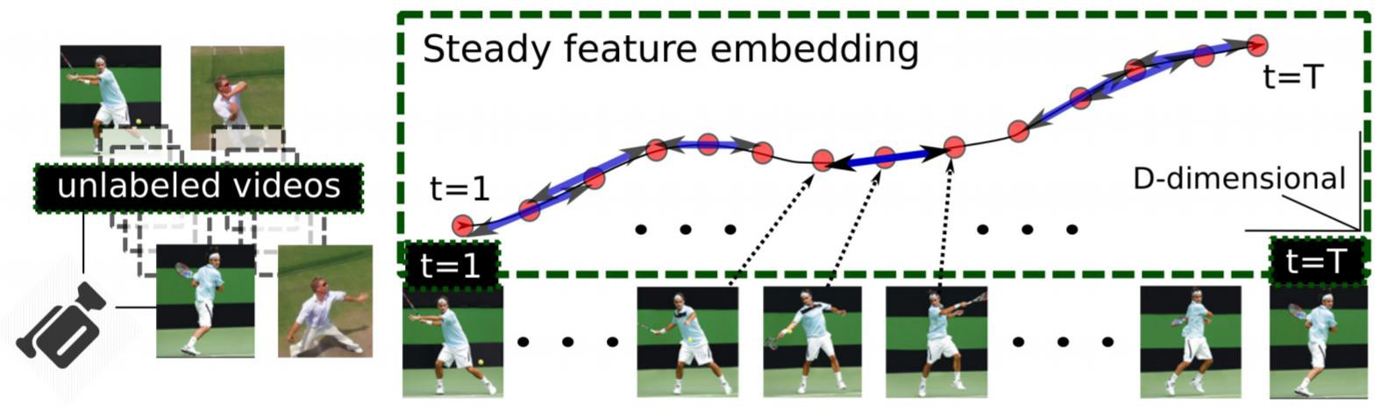
MORE MOTION
Previous paper explored ‘slow’ feature embedding
We can explore ‘steady’ feature embedding in which changes in input should
reflect similar changes in feature space
Dinesh Jayaraman, Kristen Grauman, Slow and steady feature analysis: higher order temporal coherence in video, CVPR 2016.

Slide 51
Images × Languages

Slide 52

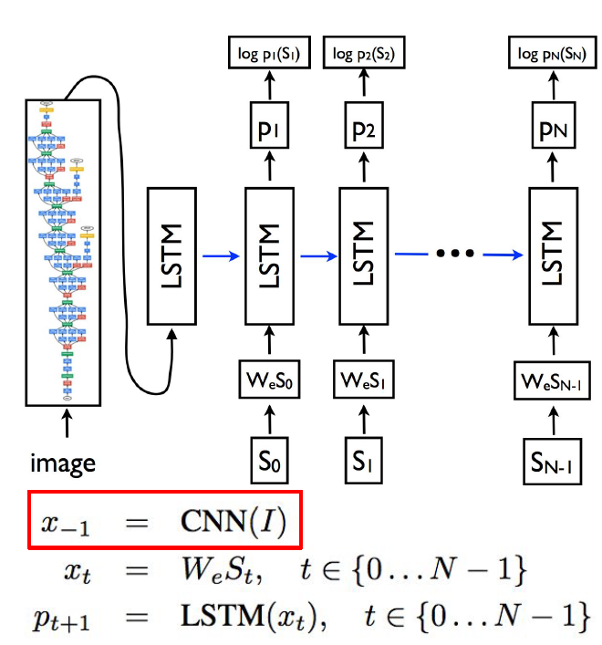





Slide 53
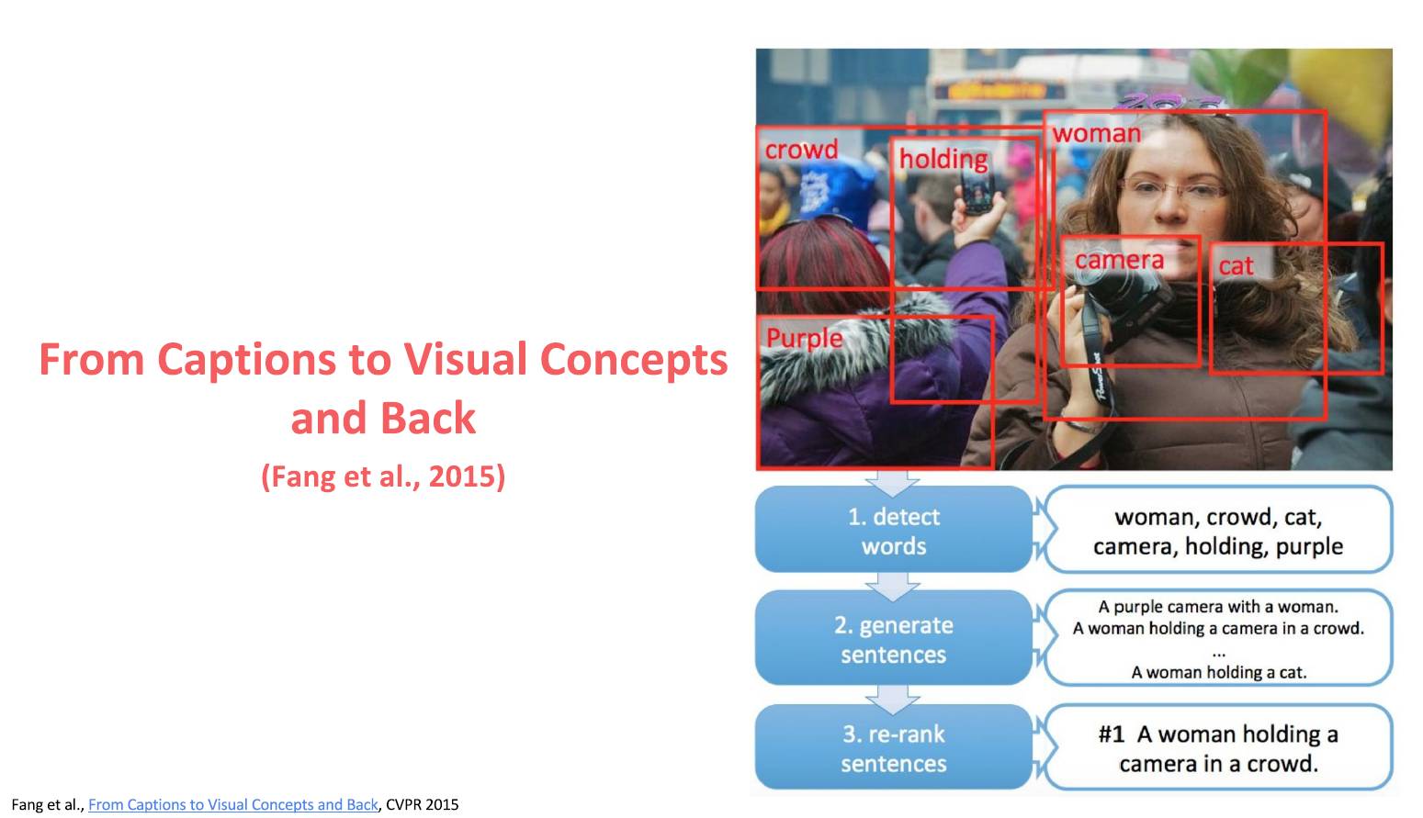

Slide 54
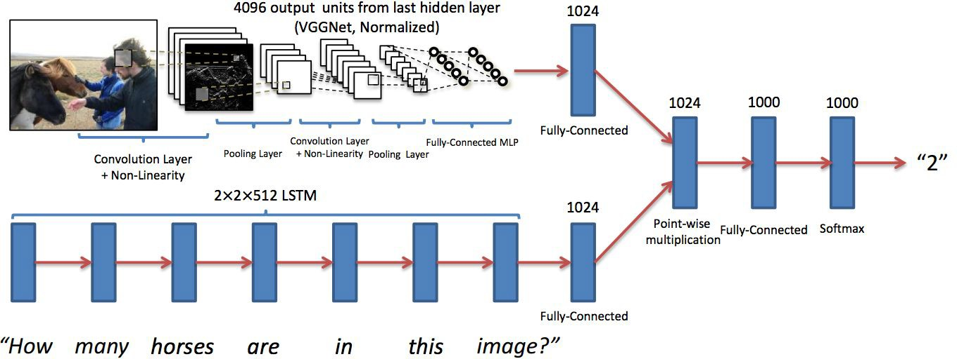
LSTM + Image feature (LSTM Q + I)
Antol, Stanislaw, et al. "Vqa: Visual question answering." Proceedings of the IEEE International Conference on Computer Vision. 2015.

Slide 55
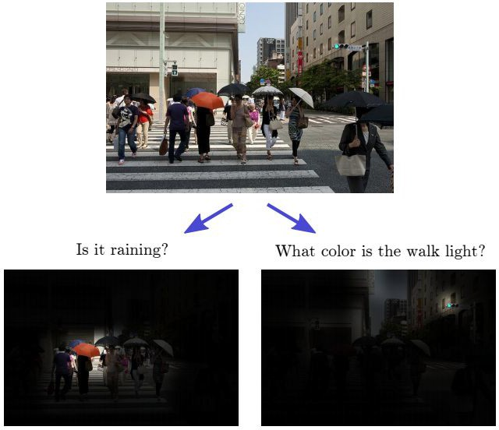
Focus on image regions to answer questions?
Shih, Kevin J., Saurabh Singh, and Derek Hoiem. "Where to look: Focus regions for visual question answering." Proceedings of the
IEEE Conference on Computer Vision and Pattern Recognition. 2016.

Slide 56
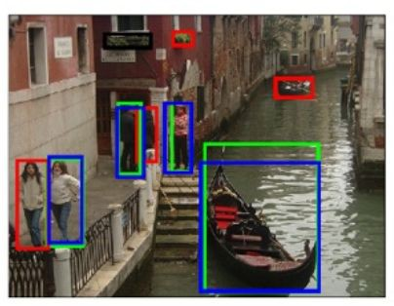
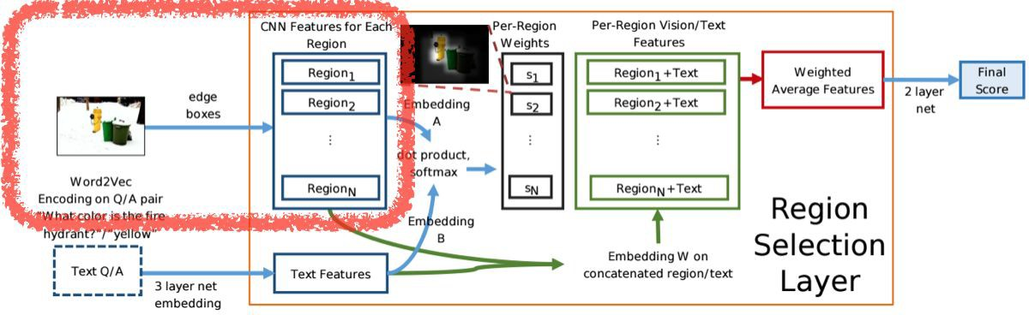
Image features
Extract top ranked 99 regions from edge box + (1 whole image)
Features are from ImageNet by VGGnets
Zitnick, C. Lawrence, and Piotr Dollár. "Edge boxes: Locating object proposals from edges." European Conference on Computer Vision.
Springer International Publishing, 2014.
Shih, Kevin J., Saurabh Singh, and Derek Hoiem. "Where to look: Focus regions for visual question answering." Proceedings of the
IEEE Conference on Computer Vision and Pattern Recognition. 2016.

Slide 57
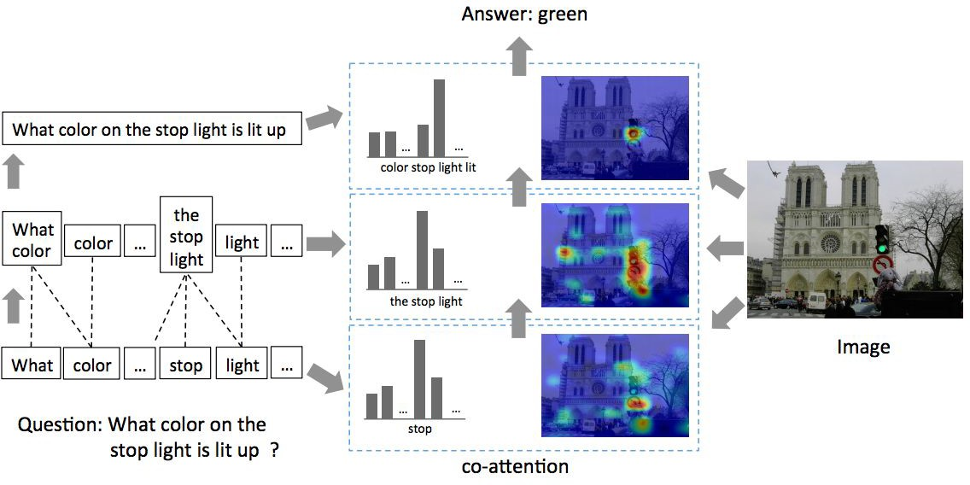

Hierarchical Question-Image Co-Attention (HieCoAtt)
Lu, Jiasen, et al. "Hierarchical question-image co-attention for visual question answering." Advances In Neural Information Processing Systems. 2016.

Slide 58
Thank you for your attention ! Questions?

